Slide 1




Access to
Primary Education Worldwide
Ildem Sanli
Helmi Chaaba
Olivier Masson
March 14, 2022
1
Notes:
Pour utiliser cette diapositive d'animation de titre avec une nouvelle image, il suffit de 1) déplacer la forme semi-transparente supérieure sur le côté, 2) supprimer l'image, 3) cliquer sur l'icône de l'image pour ajouter une nouvelle image, 4) déplacer la forme semi-transparente vers la position d'origine 5) mettre à jour le texte sur la diapositive.
1

Slide 2


« GIVE A MAN A FISH, HE’LL EAT FOR A DAY.
TEACH HIM HOW TO FISH AND HE’LL EAT FOREVER.»
2
Notes:
2

Slide 3

EXECUTIVE SUMMARY
Based on a limited dataset on access to primary education in 87 countries…
We used common data cleaning techniques in Python
We then exported our clean table to MySQL and prepared a set of queries to make our data speak
We enriched the dataset with a population table and used Matplotlib to plot country-level bubble charts
We summarized our work process in JIRA and GitHub
Notes:
3

Slide 4
OUR PROJECT FRAMEWORK
1
2
3
4
5
Project Initiation
Data Cleaning
SQL Data Processing
Data Visualization
Key Takeaways
4
Notes:
4

Slide 5


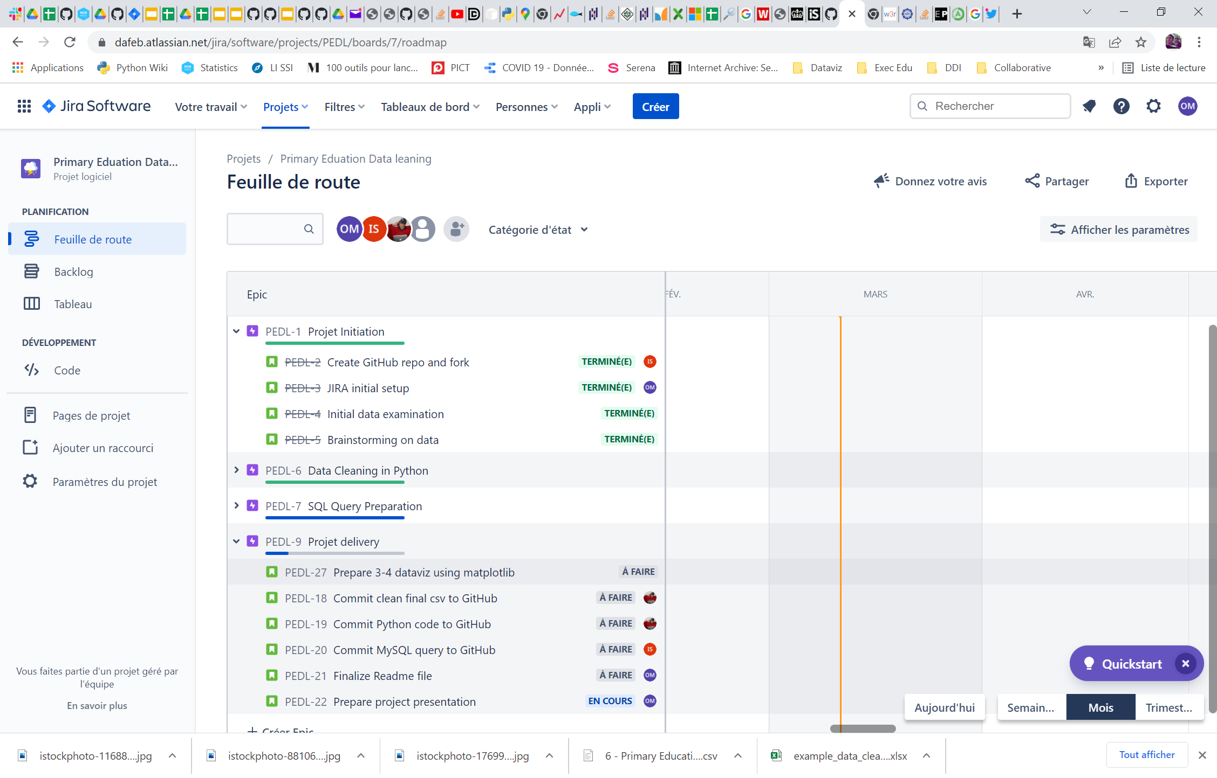
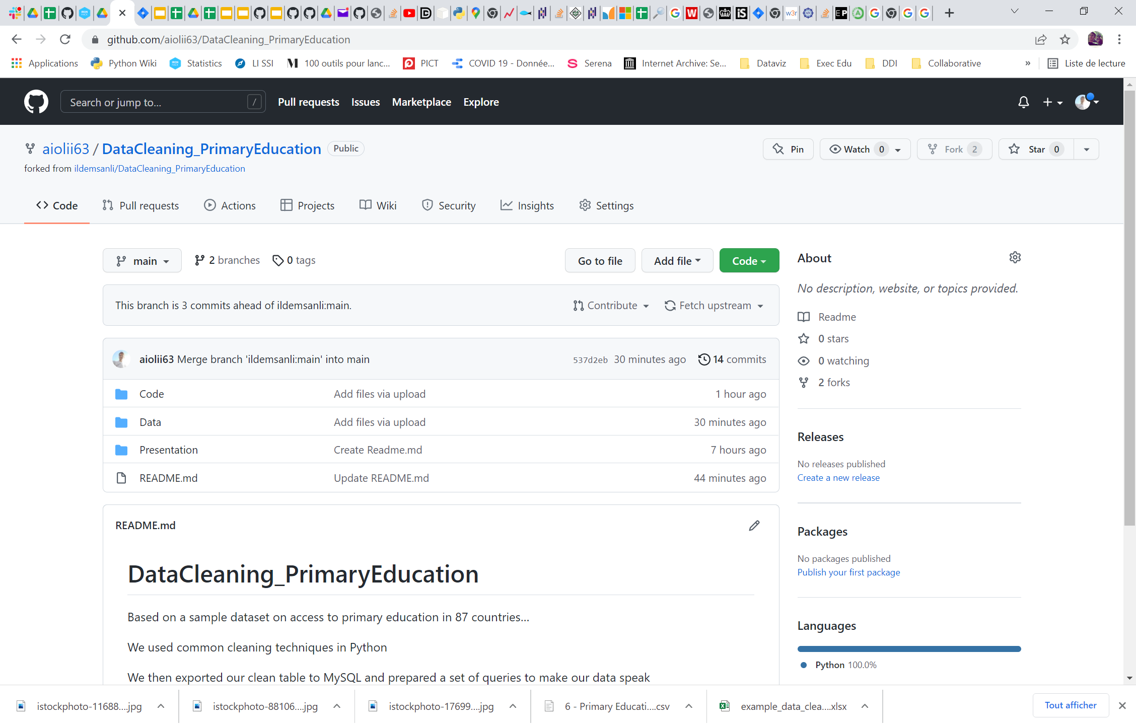
1
Project Initiation
5
Notes:
© 2014 Microsoft Corporation. Tous droits réservés. MICROSOFT N’OFFRE AUCUNE GARANTIE, EXPRESSE, IMPLICITE OU LÉGALE CONCERNANT LES INFORMATIONS DE CETTE PRÉSENTATION.
5
13/03/2022 13:45

Slide 6
OUR PROJECT FRAMEWORK
1
2
3
4
5
Project Initiation
Data Cleaning
SQL Data Processing
Data Visualization
Key Takeaways
6
Notes:
6

Slide 7
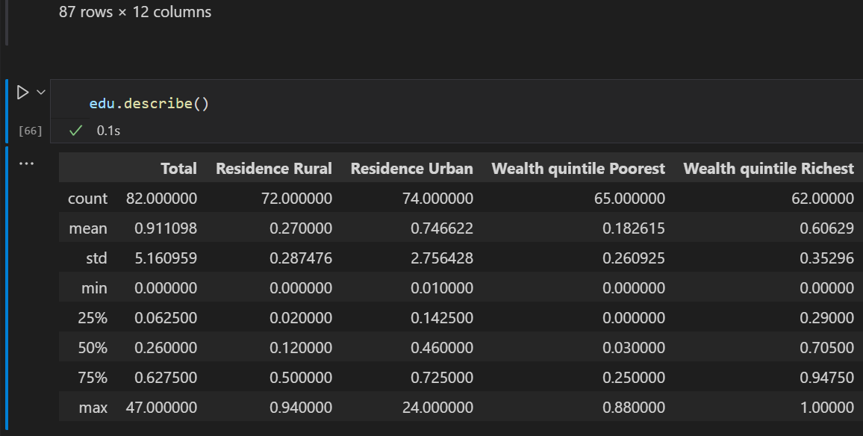
2
Data Cleaning: a weak starting point
7
Notes:
© 2014 Microsoft Corporation. Tous droits réservés. MICROSOFT N’OFFRE AUCUNE GARANTIE, EXPRESSE, IMPLICITE OU LÉGALE CONCERNANT LES INFORMATIONS DE CETTE PRÉSENTATION.
7
13/03/2022 13:45

Slide 8
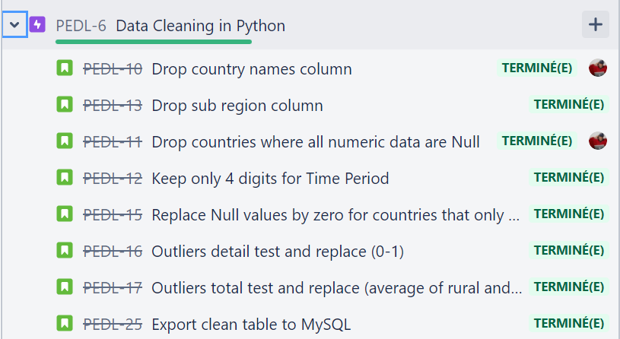
2
Data Cleaning Process
8

Slide 9
2
Our data cleaning summary
BEFORE
Short sample (87 rows x 12 columns)
Limited complexity
No duplicates
Lots of missing values
Some incorrect values in the numeric fields
Wording and data not always normalized
AFTER
Information loss limited to about 10% (new shape: 80 rows x 10 columns)
Clean fields with normalized data
Incorrect values corrected through repeatable test procedures
9

Slide 10
OUR PROJECT FRAMEWORK
1
2
3
4
5
Project Initiation
Data Cleaning
SQL Data Processing
Data Visualization
Key Takeaways
10
Notes:
10

Slide 11
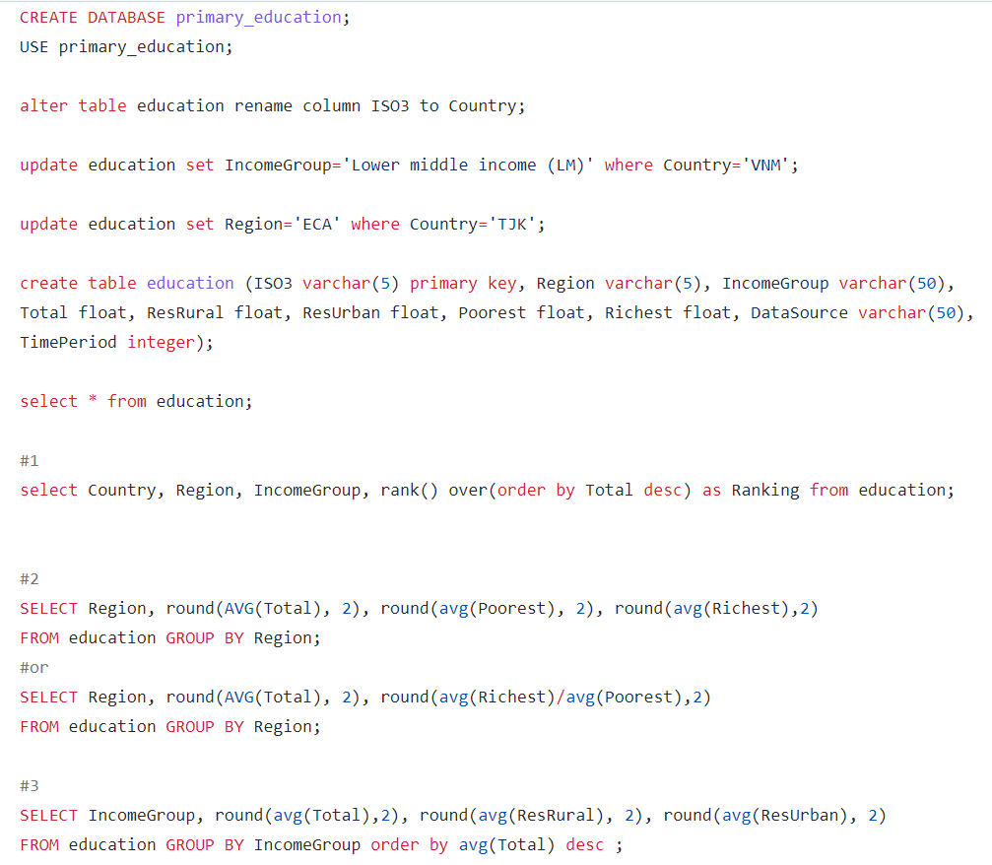
3
SQL Querying Code
11

Slide 12
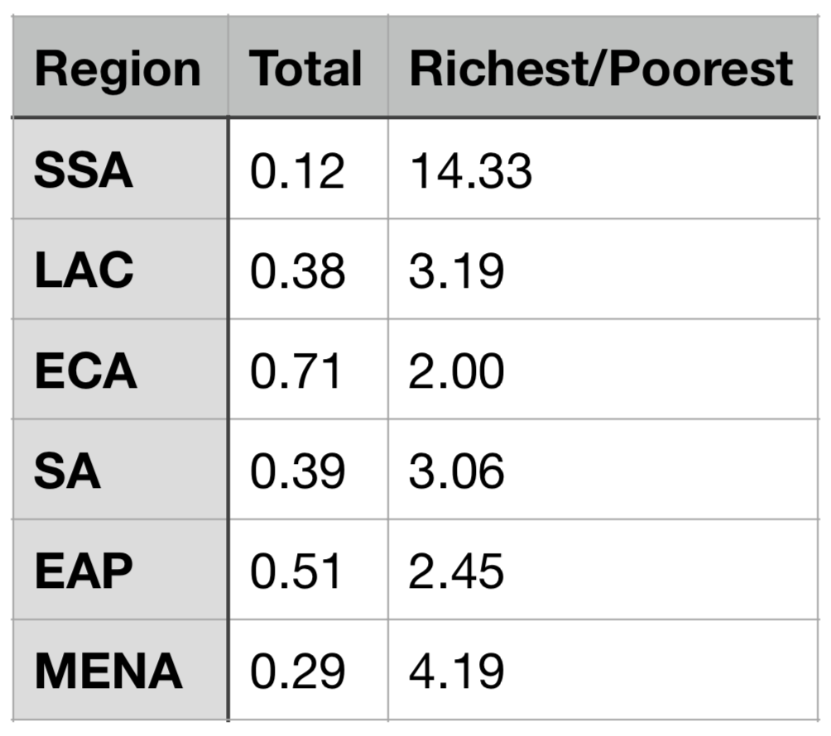
3
Access to Primary Education vastly varies from one country to another
COUNTRY RANKING Europe leads the pack in general access to Primary Education
REGION RANKING According to our dataset, SSA and MENA appear to show the widest education access gap between rich and poor
12

Slide 13
3
Our dataset seems to indicate that the more developed the country the better in term of equal access to Primary Education
RANKING BY INCOME GROUP
13

Slide 14
OUR PROJECT FRAMEWORK
1
2
3
4
5
Project Initiation
Data Cleaning
SQL Data Processing
Data Visualization
Key Takeaways
14
Notes:
14

Slide 15
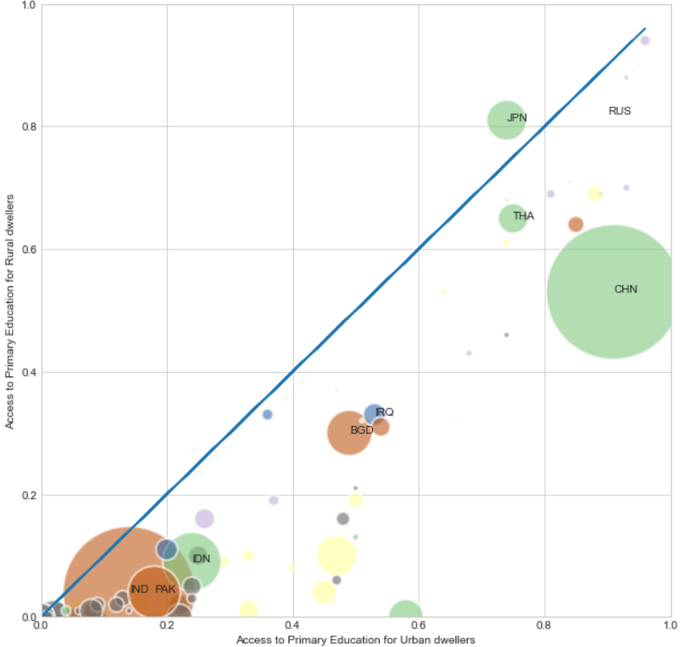
4
Urban vs rural access to primary education: at least 3 different strategic clusters
Primary education for everyone
All round limited access
to primary education
Primary education mostly limited to urban dwellers

Slide 16
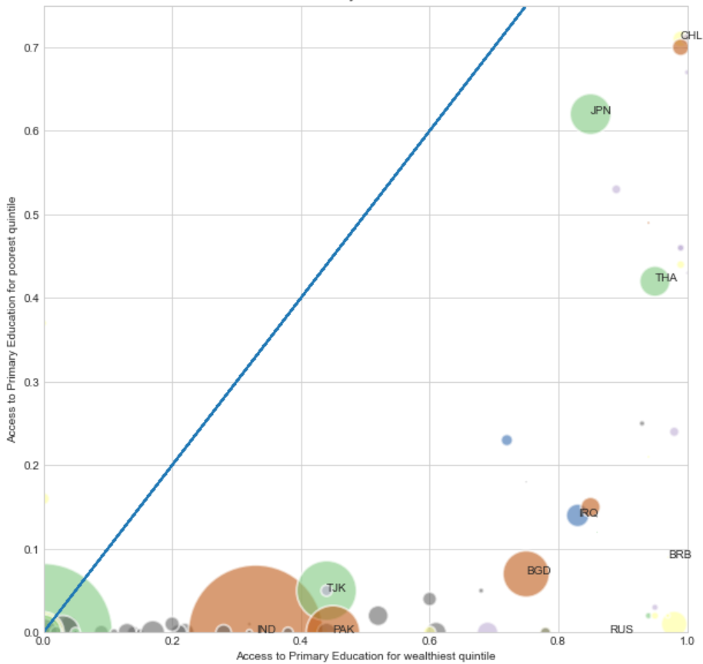
4
Access to primary education vs wealth: lack of variance on our Y axis leaves us ill-equipped to conclude
Primary education for everyone
Too many countries with zero values on our Y axis

Slide 17
OUR PROJECT FRAMEWORK
1
2
3
4
5
Project Initiation
Data Cleaning
SQL Data Processing
Data Visualization
Key Takeaways
17
Notes:
17

Slide 18
5
Key Takeaways
Data preparation is a dirty job (but someone’s got to do it)
Data cleaning requires open and transparent discussions between all stakeholders
Choices made are critical to ensure quality deliverables down the road
A limited dataset makes it harder to come to clear and actionable conclusions
The right tool for each task… (For efficiency purposes, our whole group converted to Spyder during the project)

Slide 19
NEXT STEPS
Enlarge the scope of our study to all countries worldwide
Use WBGAPI or other time series sources to add historic perspective to our study
Notes:
19

Slide 20

QUESTIONS ?
20
Notes:
Combinez une image et plusieurs instructions clés avec une grille forte.
20

